Slide 1
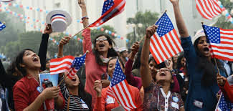
INDIAN IMMIGRATION
TO THE UNITED STATES
A Journey of Culture, Resilience, and Transformation
2.9 Million+
Indian immigrants in the U.S. today
HTY110HA | Immigration History

Slide 2
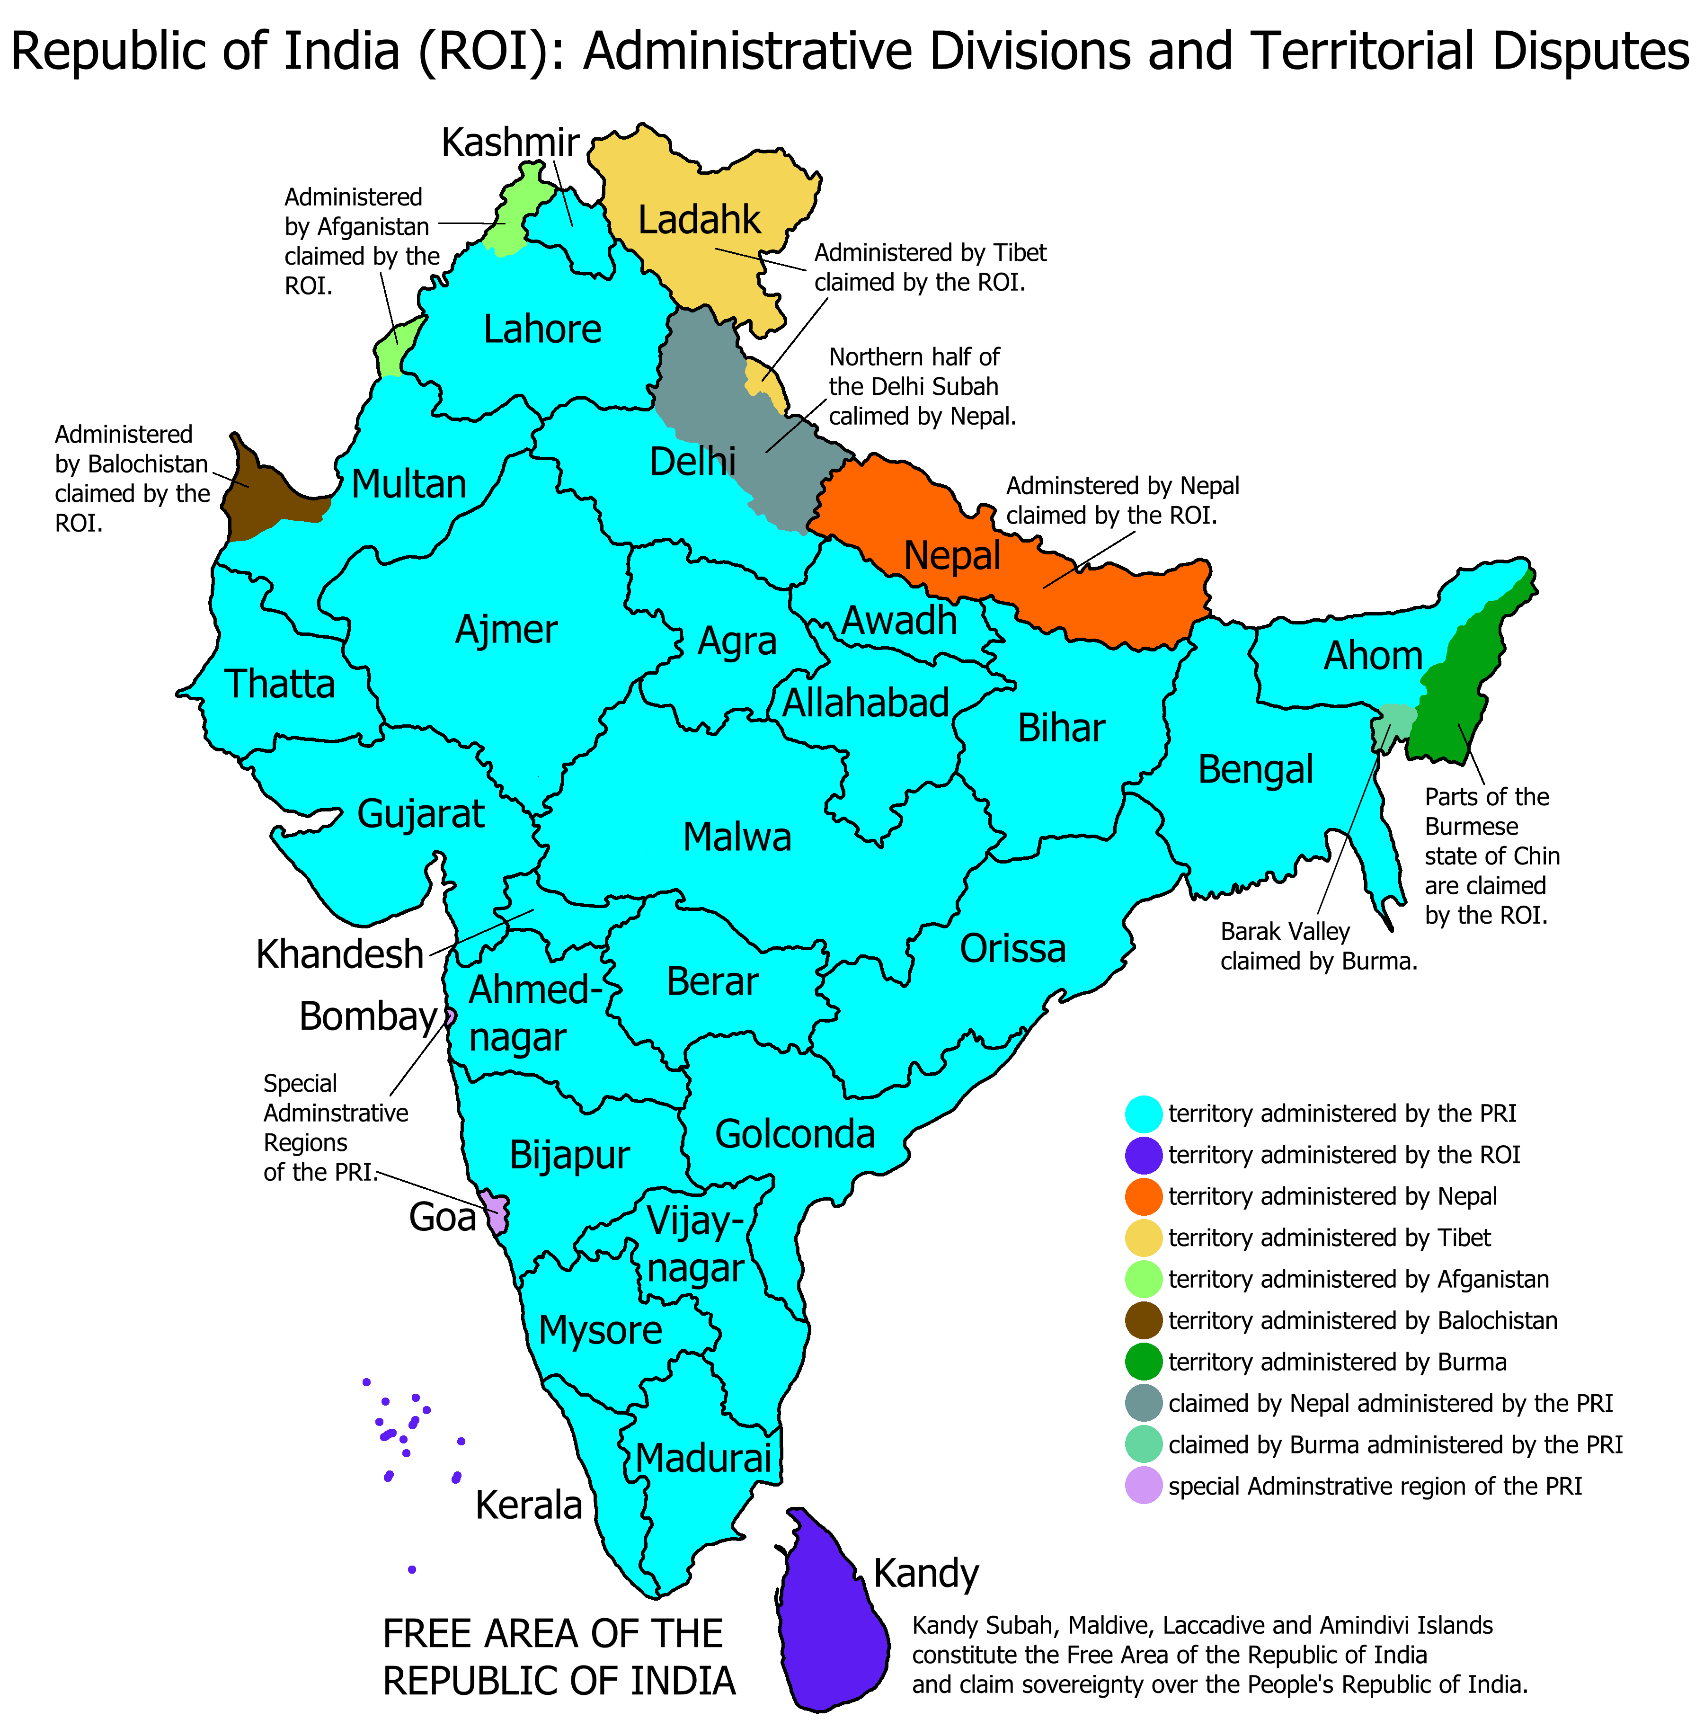
INTRODUCTION & PLACE OF ORIGIN
South Asian Origin
India is the world's most populous country (1.4 billion), located in South Asia, bordered by Pakistan, China, Nepal, and the Indian Ocean.
Diverse Nation
22 official languages, hundreds of dialects, multiple religions (Hinduism, Islam, Sikhism, Christianity, Buddhism).
Why They Came
Immigrants from all regions of India — Punjab, Gujarat, Andhra Pradesh, Tamil Nadu, Kerala — driven by education, economic opportunity, and family reunification.
Modern Diaspora
Today, Indians are the second-largest immigrant group in the U.S. (after Mexico), surpassing 2.9 million by 2023.
Republic of India

Slide 3
HISTORICAL BACKGROUND
1900s
Punjabi Sikh laborers arrive on the Pacific Coast; work in lumber mills & farms in California, Washington, and Oregon.
1907
Bellingham Riots - anti-Indian violence by white mobs drives South Asian workers from Washington state.
1923
U.S. v. Bhagat Singh Thind - Supreme Court rules Indians are not 'free white persons'; citizenship denied.
1946
Luce-Celler Act allows Indian naturalization and sets a small immigration quota of 100 per year.
1965
Immigration and Nationality Act abolishes national-origin quotas - triggers massive Indian immigration.
1990s+
H-1B visa program fuels arrival of Indian tech workers; Silicon Valley becomes a hub of the Indian diaspora.

Slide 4
PUSH & PULL FACTORS
⬆ PUSH - Leaving India
⬆ PULL - Arriving in the U.S.
Limited professional opportunities for educated Indians despite high qualifications
Overpopulation pressure & competition for white-collar jobs
British colonialism (pre-1947) : economic exploitation & land displacement, especially in Punjab
Caste-based social discrimination limiting mobility
Partition of 1947 : massive displacement of millions between India & Pakistan
Low wages relative to Western nations for skilled professionals
1965 Immigration Act: opened doors to skilled workers & family reunification
H-1B visa program: attracted engineers, doctors, and IT professionals
High demand for STEM talent, especially during the tech boom of the 1990s
Higher wages and a superior standard of living
Family chain migration: existing Indian communities facilitated further immigration
Academic opportunities at prestigious U.S. universities

Slide 5
SKILLS & ASSETS
~75%
#1
$119K
15%+
hold a bachelor's
degree or higher
median household
income among all
immigrant groups
median annual
household income
(2023)
of U.S. doctors &
physicians are
Indian-American
High Education
Medical Professions
English Proficiency
Many arrive with advanced degrees in engineering, medicine, science, and business. U.S. universities recruit Indian graduate students in large numbers.
Indian-American physicians have served rural and underserved U.S. communities. They constitute one of the largest foreign-born physician groups.
India's colonial history means English is an official language, giving Indian immigrants an immediate communication advantage unlike many other groups.
STEM Expertise
Entrepreneurship
Cultural Richness
Indian immigrants dominate H-1B visa rolls in software, IT, biotechnology, and pharmaceutical research , forming the backbone of Silicon Valley.
Indians founded or co-founded companies including Google, Adobe, and Palo Alto Networks. About 8% of U.S. high-tech startups have Indian founders.
Indian immigrants brought yoga, Ayurvedic medicine, Bollywood, classical dance, and a rich culinary tradition that has deeply influenced American culture.

Slide 6
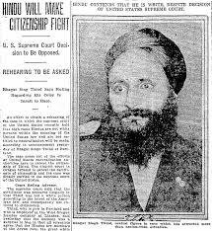
LIABILITIES & BARRIERS FACED
Racial Exclusion (1917–1946)
01
The Barred Zone Act (1917) banned immigration from most of Asia. U.S. v. Thind (1923) stripped Indians of citizenship rights, classifying them as non-white.
Xenophobia & Anti-Asian Violence
02
The 1907 Bellingham Riots saw white mobs attacking Sikh workers. Post-9/11, Sikhs faced widespread hate crimes due to turbans misidentified as Arab dress.
Visa Backlogs & Immigration Limbo
03
Indian nationals face the world's longest green card waits — sometimes 100+ years — due to per-country caps in employment-based immigration.
Racial & Workplace Discrimination
04
Despite high qualifications, Indian immigrants face 'glass ceiling' effects, accent discrimination, and are often underrepresented in senior leadership.
Cultural & Religious Stereotyping
05
Indian immigrants face stereotypes as model minorities, which erases diversity within the community and dismisses real economic hardship faced by many.
Bhagat Singh Thind
denied citizenship by the
U.S. Supreme Court (1923)

Slide 7
POPULATION GROWTH: INDIAN IMMIGRANTS IN THE U.S.
Key Milestones
1965
Immigration & Nationality Act , new quotas abolished
1990
H-1B visa program launched
2000s
Tech boom drives STEM demand
2023
2.9M+ Indians now in U.S.today
Migration Policy Institute, MPI tabulation of U.S. Census Bureau ACS data (Batalova & Lee, Nov. 2024)

Slide 8
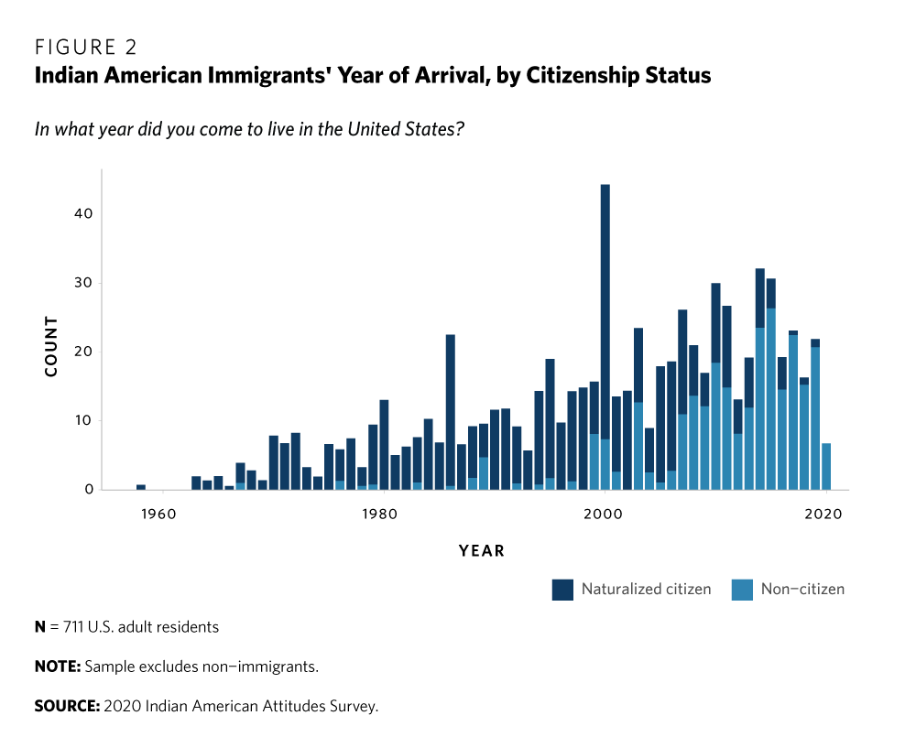
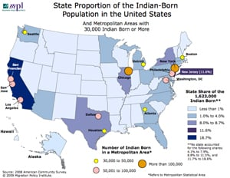
EARLY SETTLEMENT PATTERNS
1900s–1940s — Pacific Coast
First wave: Punjabi Sikhs settled in California's Central Valley (Fresno, Stockton, Yuba City) as farm laborers, later becoming small landowners.
Post-1965 — Major Metros
Scientists, doctors, and engineers flocked to New York, Chicago, Los Angeles, Houston, and New Jersey suburbs near corporate employers.
1990s–2000s — Silicon Valley
Indian IT workers concentrated in San Jose, Fremont, Sunnyvale, and surrounding Bay Area suburbs; shaped the tech industry landscape.
Chain Migration Hubs
The years of arrival –the highest Indian immigrant
Edison (NJ), Artesia (CA), and Devon Avenue in Chicago became cultural and commercial anchors of the Indian diaspora.
States with the highest Indian immigrant populations:
California, New Jersey, Texas, New York, Illinois

Slide 9
OCCUPATIONAL CONCENTRATION
Notable Contributions
~70% of H-1B visas go to Indian nationals — primarily in software & IT
~15% of all U.S. doctors are of Indian origin; critical in rural underserved areas
Indian-Americans founded or co-founded Microsoft (Satya Nadella), Google (Sundar Pichai), Adobe & more
Over 200,000 Indian students enroll annually in U.S. universities — largest international student group
Indian-Americans have the highest median household income of any ethnic group in the U.S.
Migration Policy Institute (Batalova & Lee, 2024); U.S. Census ACS 2022

Slide 10
CHALLENGES FACED
Early 1900s
Mid-Century
Legal Exclusion & Violence
Quota Restrictions
Barred Zone Act 1917, U.S. v. Thind 1923, Bellingham Riots 1907. Indians were denied citizenship, property rights, and faced mob violence.
The 1917–1965 era saw only 100 Indians allowed per year. Families were separated; skilled professionals had no legal path to remain.
Post-9/11
Present Day
Racial Profiling & Hate Crimes
Green Card Backlog Crisis
Sikhs in particular faced violence due to turbans. Balbir Singh Sodhi was murdered in Arizona days after 9/11 in a hate crime.
Due to per-country caps, Indian immigrants in the employment-based queue could wait 100+ years for permanent residency - called 'immigration limbo.'
Cultural
Economic
Identity & Belonging
Model Minority Myth
Second-generation Indian-Americans navigate between two cultures, often facing pressure from both communities regarding identity, marriage, and career.
The stereotype erases socioeconomic diversity within the community — many Indian immigrants face poverty, particularly refugees and non-STEM migrants.

Slide 11
SETTLEMENT PATTERNS & EXPERIENCES TODAY
Community Today
Cultural Enclaves
Little India districts exist in New York, Chicago, San Jose, and Houston with temples, restaurants, and cultural events.
Political Representation
Vice President Kamala Harris (of Indian heritage), Nikki Haley, and Ro Khanna represent growing Indian-American political power.
Religious Communities
Over 900 Hindu temples in the U.S.; Sikh gurdwaras, mosques, and churches serve diverse Indian immigrant communities.
2nd Generation
U.S.-born children of Indian immigrants are highly educated and prominent in medicine, law, tech, finance, and politics.
Transnational Ties
Indians are the largest source of remittances globally; strong cultural, familial, and economic ties to India are maintained.
Source: Migration Policy Institute / U.S. Census ACS 2018-22 (Batalova & Lee, 2024)

Slide 12
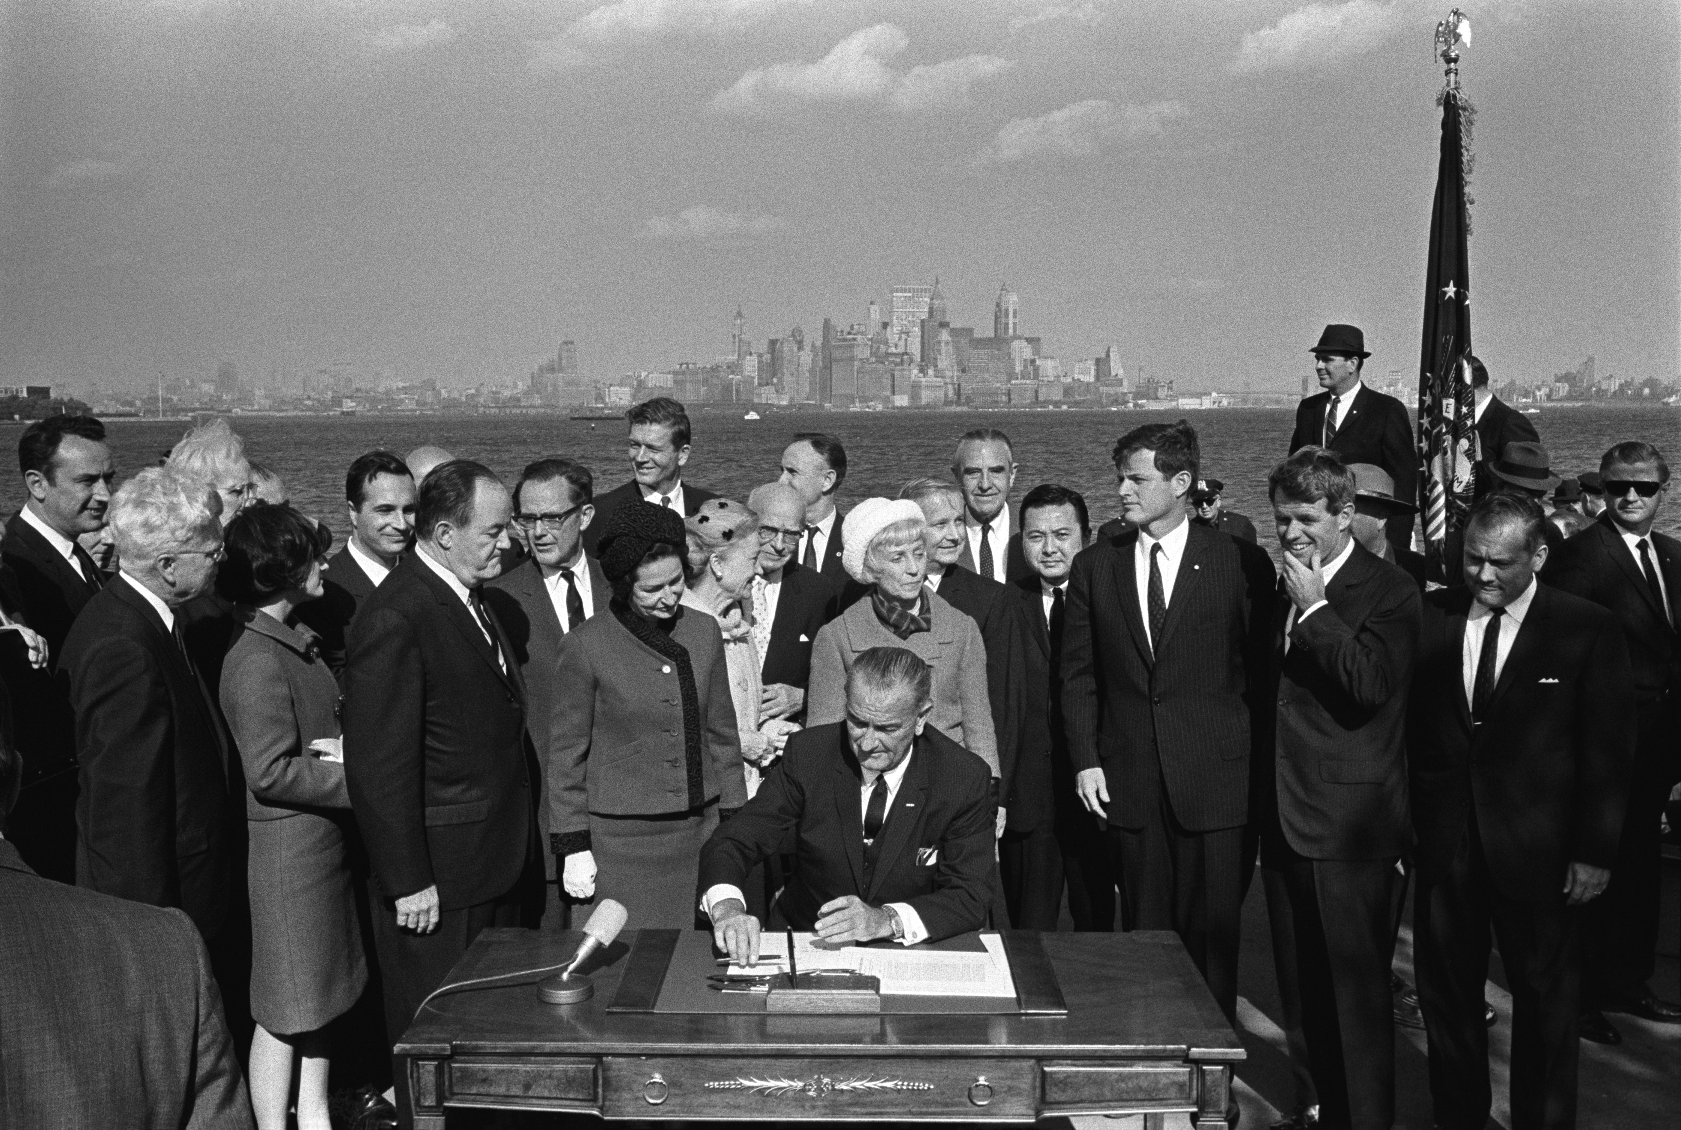
THE TURNING POINT: IMMIGRATION & NATIONALITY ACT OF 1965
Why This Matters for Indian Immigration
Abolished the national-origin quota system that had effectively banned most Asians since 1924
Prioritized family reunification and employment-based skills , precisely what highly educated Indians offered
Indians went from 18,638 arrivals in the 1960s to nearly 148,000 in the 1970s
Created a new preference category for professionals, scientists, and artists , tailor-made for India's educated class
President Lyndon B. Johnson signs the Immigration & Nationality Act, October 3, 1965 , Statue of Liberty, NY
Chain migration allowed early Indian immigrants to sponsor family members, building permanent communities
"Without the 1965 Immigration Act, the Indian-American community as we know it today simply would not exist."

Slide 13
CONCLUSION
Indian immigration is one of the most transformative demographic stories in U.S. history
From exclusion and racial violence (1900s–1946) to legal inclusion and economic success (post-1965)
The 1965 Immigration Act was the singular turning point enabling mass Indian immigration
Indian Americans today are the most educated and highest-earning immigrant group in the nation
Yet challenges remain — visa backlogs, discrimination, and the model minority myth persist
Their story reflects both America's broken promise and its enduring ideal as a nation of immigrants

Slide 14
Word Cited
1
Batalova, Jeanne, and Abby Lee. "Indian Immigrants in the United States." Migration Policy Institute, Nov. 2024, www.migrationpolicy.org/article/indian-immigrants-united-states. Accessed 10 Apr. 2026.
2
Lal, Vinay. "Indians in the US." MANAS: South Asian History and Culture, UCLA, southasia.ucla.edu/diaspora/indians-in-the-us/. Accessed 10 Apr. 2026.
3
Lee, Erika. The Making of Asian America: A History. Simon & Schuster, 2015.
4
United States, Supreme Court. United States v. Bhagat Singh Thind. 261 U.S. 204, 1923.
5
Jensen, Joan M. Passage from India: Asian Indian Immigrants in North America. Yale University Press, 1988.
6
U.S. Census Bureau. "American Community Survey 2018-2022." U.S. Department of Commerce, www.census.gov/programs-surveys/acs.
Note: All sources accessed via Saint Leo University Library (SLU Library Database) and credible academic/governmental repositories.

Slide 15
Presentation Summary
This presentation explains Indian immigration to the United States with 14 fully designed slides, beginning with an overview of India as a South Asian nation of 1.4 billion people and the origins of immigrants from places like Punjab, Gujarat and Tamil Nadu. The presentation goes on to describe the historical timeline from the early 1900s Punjabi agricultural workers, through the 1907 Bellingham Riots, the 1923 U.S. v. Thind court case which denied Indians citizenship, to the 1965 Immigration and Nationality Act that changed everything. Push factors are explained including British colonialism, the 1947 Partition, caste discrimination, and limited economic opportunities. Pull factors are explained including the H-1B visa program, STEM demand, family reunification and higher wages. A line chart shows population growth from 206,000 in 1980 to 2.9 million in 2023. A bar chart shows the top three destination states California, New Jersey and Texas. A pie chart shows occupational concentration with 32% in Technology and IT, 22% in medicine. Skills and assets include English language proficiency, entrepreneurship and cultural

