Slide 1



page 01
LDR 5301 Assignment (Part 1)
Presented By:

Slide 2

Outline
Business Overview & Tools Selected
How Each Tool Measures Data
External Variables Affecting Analysis
Queuing Theory Data & Results
Probability & Distribution Data & Results
Decision Tree Data & Results
Key Findings & Improvements Required
Decision-Making Process
Correlation Analysis
Final Recommendation to Supervisor
page 02

Slide 3
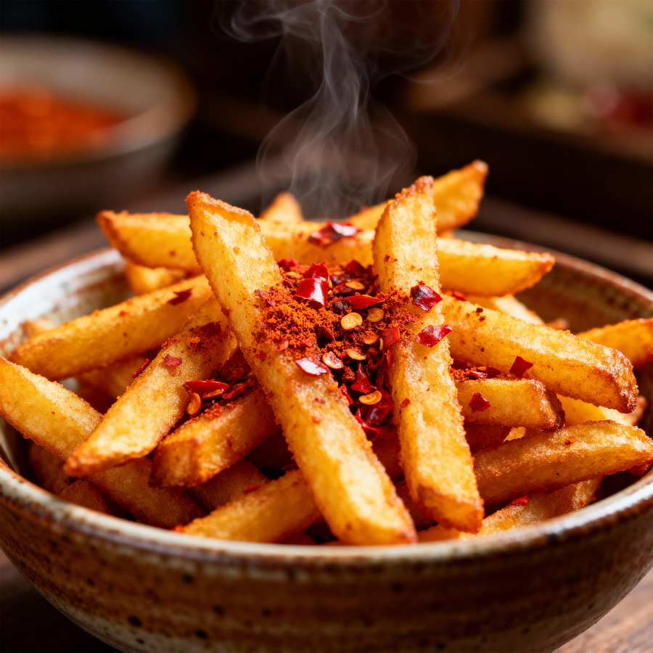
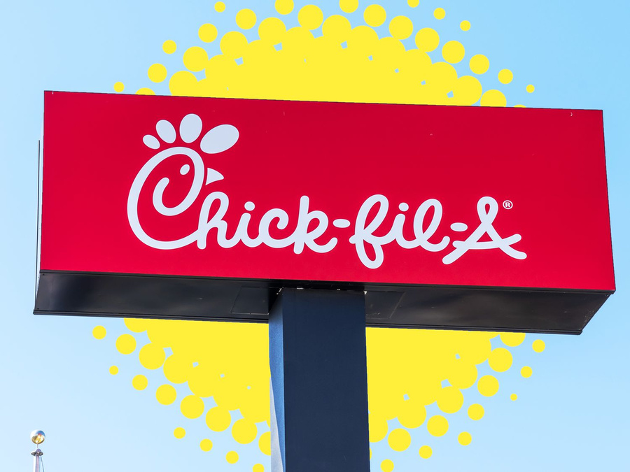
Business Overview & Analytical Tools Selected
page 03
Chick-fil-A: ~3,000 U.S. locations, $21.6B system sales (2023), closed Sundays (Chick-fil-A, 2025)
Operations focus: drive-thru throughput, staffing, and order fulfillment
Tool 1: Queuing Theory — measures wait times and lane capacity
Tool 2: Probability & Distributions — models customer arrival patterns
Tool 3: Decision Tree — evaluates staffing and operational investment options
Notes:
Chick-fil-A is operational and efficient, and one of the most successful quick-service restaurants in the United States of America, generating 21.6 billion in system-wide sales across roughly 3,000 locations in 2023, but never opens on Sundays. This presentation targets, in particular, drive-thru throughput, staffing allocation, and order fulfillment as the core areas of operation to be reviewed. The three tools are chosen as a newly hired data analytics manager, and an in-depth analysis is planned. Queuing Theory will quantify the capacity of lanes and the wait times for customers. Customers coming during the day will be modeled using Probability and Poisson Distributions. Lastly, the Decision Tree Analysis will compare operational investments in competition based on Expected Monetary Value. A combination of all three tools offers an all-encompassing, data-based framework for the measures to be taken to achieve business operational profitability.

Slide 4
page 04
Tool | What It Measures | Key Metric
Queuing Theory (M/M/c) | Wait time, lane utilization (Zulkarnain & Sudin, 2024) | ρ = λ/μ ≤ 0.85 target
Poisson Distribution | Customer arrival rate (Ayodeji & Rjoub, 2021) | λ per 15-min interval
Decision Tree | Revenue per staffing scenario ((Bansal et al., 2022) | Expected Monetary Value (EMV)
How Each Tool Measures Data
Queuing model calculates system utilization ratio (ρ)
Poisson fits random arrivals; normal distribution fits prep times
Decision tree assigns probabilities to demand outcomes
Notes:
The different analysis tools address various functional aspects. According to the Queuing Theory, the M/M/c multi-server model is a theory that calculates system utilization (ρ = λ/μ), where λ is the customer arrival rate, and μ is the service rate. To keep the conditions of queues unchanged, rho is set to the industry benchmark of at most 0.85 (Zulkarnain & Sudin, 2024). The Poisson Distribution can be used when it is essential to model the customer arrivals, as the arrivals are independent and unpredictable during the service windows. The time of prep in the kitchen is normally distributed, and the time tends to follow a more predictable trend (μ = 2.8 min, σ = 0.6) (Ayodeji & Rjoub, 2021). The Decision Tree assigns probabilities to three demand scenarios (high, moderate, and low) and computes the expected monetary value for each operational decision (Bansal et al., 2022). With respect to the fast-food setting, Bansal et al. (2022) observe that employment optimization, along with throughput modeling, offers the most operational insights that have the greatest actionability.

Slide 5
Variables Affecting Data
page 05
Time of Day | Day of Week | Weather | Holidays
Peak demand 11:30 AM–1 PM and 5–7 PM; arrival rate rises 60–80% (Ayodeji & Rjoub, 2021) | Fridays/Saturdays 25–30% higher volume; Mondays lowest (Ayodeji & Rjoub, 2021) | Rain shifts customers to drive-thru; extreme temps cut foot traffic ~12% (Ayodeji & Rjoub, 2021) | Pre-holiday Fridays spike demand 35–40% above baseline (Ayodeji & Rjoub, 2021)
Notes:
The presence of external variables has a great effect on the reliability and interpretation of operational data. The time of the day is the most influential; the arrival rates are higher by 60-80 percent during the two busy periods between 11.30 AM and 1.00 PM and between 5.00 PM and 7.00 PM in comparison with low-activity periods. The issues of the day of the week are also essential: Fridays and Saturdays are always characterized by 25 to 30 percent more transactions than the lowest days (Mondays). The weather has a direct impact on customer behavior: rainfall boosts the use of drive-through by cramping the walk-in traffic by about 12 percent. The demand peaks during holiday seasons, especially on the eve of Thanksgiving and Christmas, and reaches 35-40 percent higher than normal levels. Ayodeji & Rjoub (2021) argue that these variables may cause systematic underperformance during the peak periods and excessive staffing during the low-demand windows without their consideration in the staffing models.

Slide 6
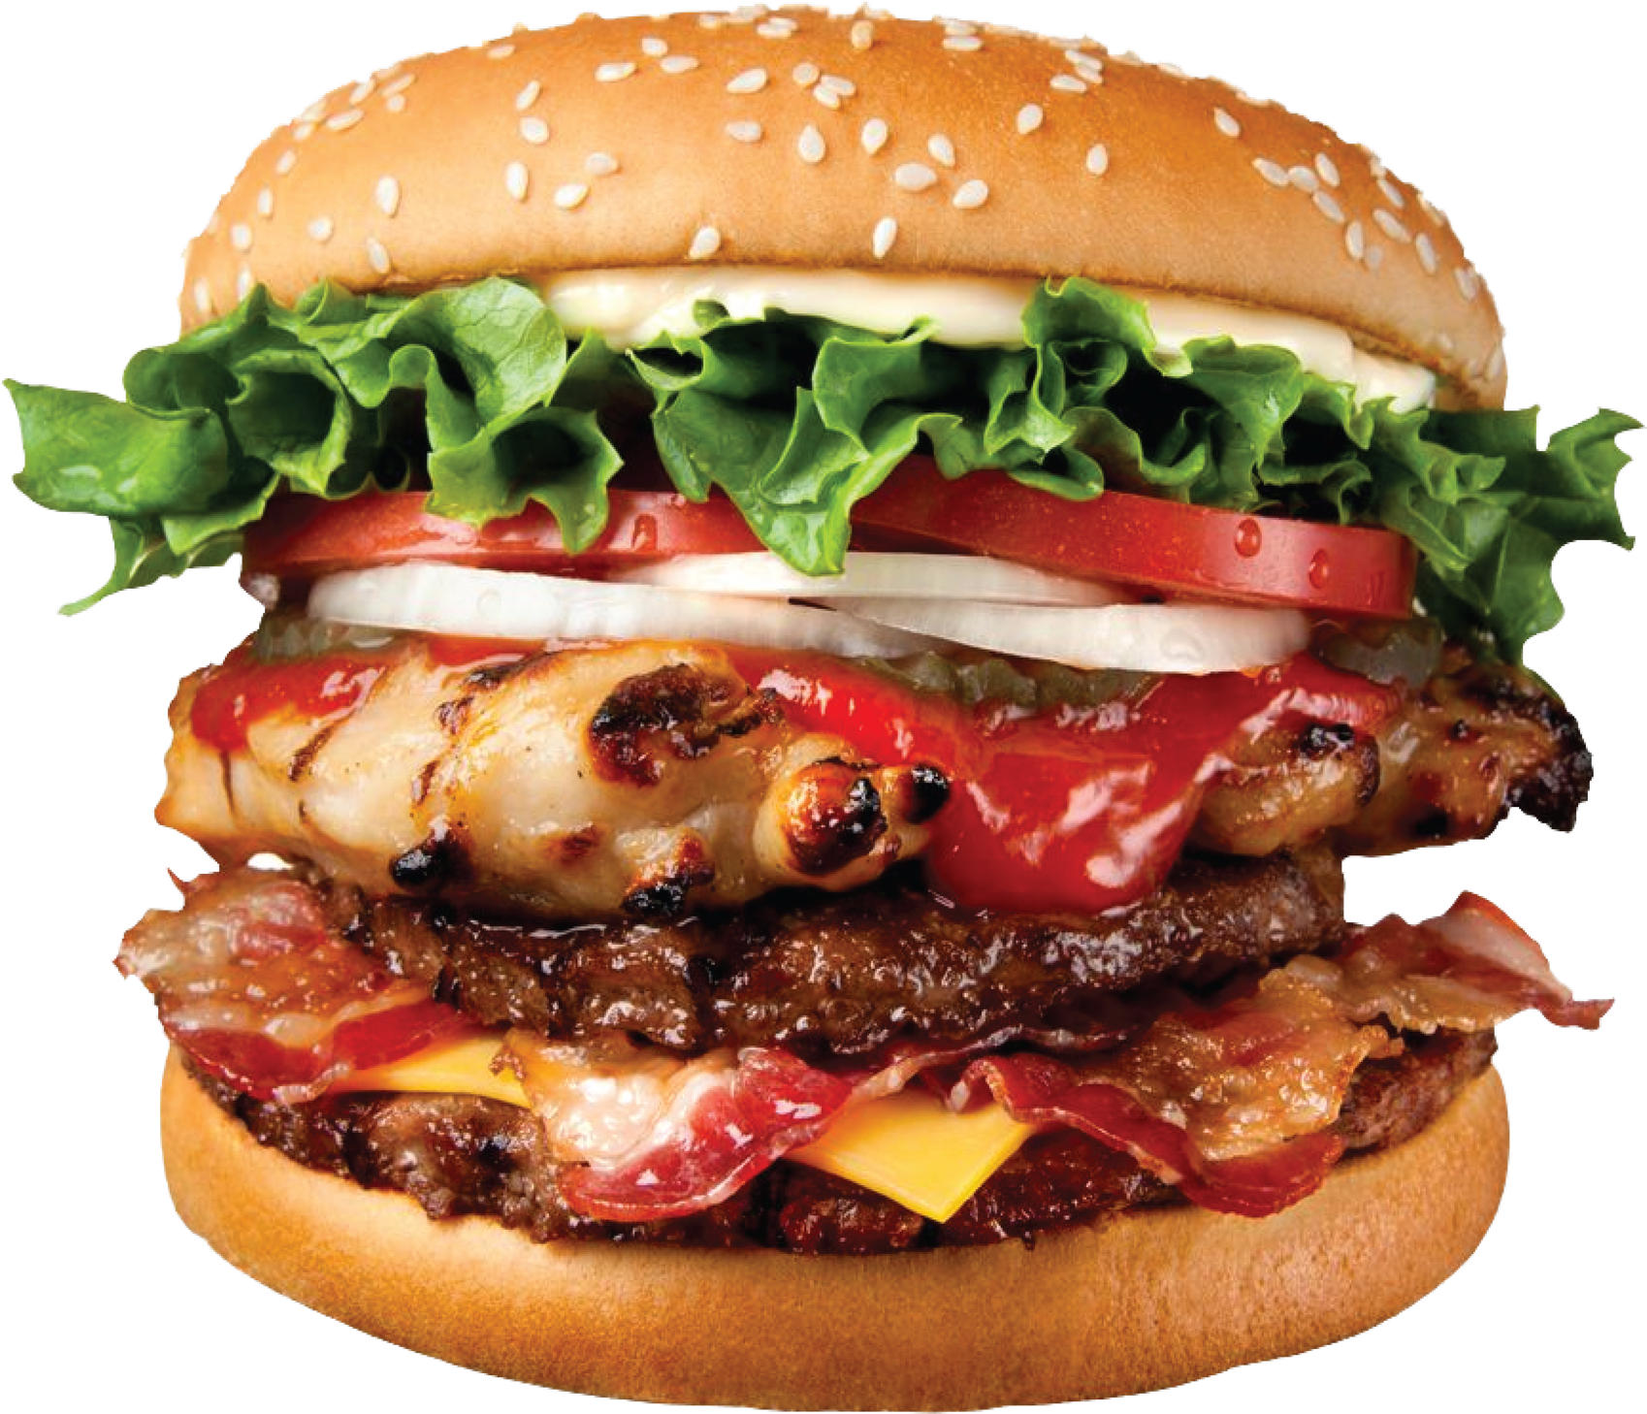
Queuing Theory Data
page 06
Time Window | λ (arrivals/hr) | μ (service/hr) | Utilization ρ | Avg. Wait (min)
Off-Peak (9–11 AM) | 40 | 60 | 0.67 | 1.8
Lunch Peak (11:30–1 PM) | 90 | 100 | 0.90 | 8.1
Afternoon (2–4 PM) | 30 | 60 | 0.50 | 1.0
Dinner Peak (5–7 PM) | 85 | 100 | 0.85 | 5.3
M/M/c model applied with c = 2 lanes at peak hours
Industry benchmark: ρ ≤ 0.85; lunch peak at 0.90 exceeds threshold
Notes:
The table gives the queue data that were observed during the four time windows of the day under the M/M/c model, which has two working drive-thru lanes during the busiest periods. The system can comfortably run at ρ =0.67 during the off-peak morning hours with an average wait of 1.8 minutes. The afternoon window is also stable at ρ = 0.50. The peak lunch, however, raises a serious issue - it utilizes 0.90 with an average wait time of 8.1 minutes. The dinner peak of ρ = 0.85 is directly at the industry threshold. A ρ nearing and above 0.85 indicates that wait time should exhibit exponential growth, and not linear growth, according to the queuing theory: that is, any small increment in the number of arrivals will result in an incommensurate increase in wait time. According to Ayodeji & Rjoub (2021), when perceived wait time exceeds five minutes, customer satisfaction and repurchase intention are also negatively impacted in service scenarios.

Slide 7
Probability & Distribution Data
page 07
Day | Avg. Arrivals/15 Min | Std. Dev. | P(Wait > 5 min)
Monday | 18 | 3.2 | 0.12
Wednesday | 24 | 4.1 | 0.28
Friday | 31 | 5.6 | 0.47
Saturday | 34 | 6.0 | 0.55
Arrivals follow Poisson distribution; prep time follows normal (μ = 2.8 min, σ = 0.6)
Friday/Saturday exceed 45% probability of a 5-min+ wait
Notes:
This table uses the models of the Poisson distribution for the customer arrivals in four days of the week during the lunch peak period. The lowest arrival rate at 18 customers per 15-minute is shown on Monday, with only 12 percent chances of waiting longer than five minutes. By Friday, the arrival rate also soars to 31, requiring the likelihood that the wait time is five minutes or above to be 47 percent. The worst day is on a Saturday when there are 34 arrivals every interval and a 55 percent likelihood of having too much wait. A normal distribution with a mean of 2.8 minutes and a standard deviation of 0.6 minutes was independently used to model kitchen prep time. This confirms that prep time is not the major bottleneck - it is the volume of arrivals. Bansal et al. (2022) confirm that the primary cause of customer dissatisfaction in fast-food restaurant queuing systems is arrival rate variance rather than service speed.

Slide 8
Decision Tree Data
page 08
Decision | High Demand (P=0.45) | Moderate (P=0.35) | Low (P=0.20) | EMV
A: Add 3rd Lane | $18,500 | $14,200 | $9,800 | $14,840
B: Expand Mobile Orders | $16,200 | $13,800 | $11,500 | $14,175
C: Status Quo | $13,000 | $12,500 | $11,000 | $12,400
Decision A yields highest EMV at $14,840/week
Status quo underperforms both alternatives by 12–20%
Notes:
A decision tree was applied to analyze three demand probability situations and three strategic decisions. Decision A, which would entail the inclusion of a third drive-thru lane, generates the highest Expected Monetary Value of $14,840 per week per location at performances of $18,500, at peak conditions of high demand. Decision B - raising mobile order incentives- has an EMV of 14,175 and provides a more consistent revenue at all levels of demand with reduced variance. Decision C -the status quo- only yields $12,400 of EMV/week, or 12 to 20 percent worse than both of the alternatives. The EMV formula used is the addition of the product of respective probabilities and the products of the results of the respective revenues. The finding that digital ordering investment results in significant throughput/revenue benefits in the Quick-service restaurant setting is supported by Eshan et al. (2025), who state that these benefits occur especially during high-demand periods.

Slide 9
page 09
Lunch peak ρ = 0.90 exceeds safe threshold — avg. wait reaches 8.1 minutes
Results & Improvements Required
Saturday P(wait > 5 min) = 55% — unacceptable for customer retention
Status quo EMV ($12,400) trails best alternative by $2,440/week per location
Improvements needed: Add express lane; increase Friday/Saturday staffing by 2 FTE
Notes:
The data indicate two severe operation failures. First, the peak utilization rate of 0.90 is more than the safe operational rate, and that leads to the creation of an average of an 8.1-minute waiting period that has a direct impact on customer loss. Secondly, the 55 percent on Saturday of waits that are over five minutes is a systematic capacity issue, not an incident. Cuento et al., (2025) determine that in quick-service environments, customer turnover is higher when wait times are longer than five minutes. In financial terms, the status quo EMV of 12,400 is less than the best alternative, 2,440/week, or 126,400/year/location in unrealized revenues. The effort needs improvements on two fronts: physical capacity increase with the addition of an express lane, and a 2-fold full-time equivalent demand-directed staff increase during the peak periods on Fridays and Saturdays.

Slide 10
Decision-Making Process
page 10
Step 1 | Problem | Peak overflow on Fri/Sat causing revenue leakage and attrition
Step 2 | Alternatives | Lane expansion (A), mobile incentives (B), dynamic scheduling (C)
Step 3 | Evaluate | Lane expansion drops ρ from 0.90 → 0.72; mobile reduces λ by 15%
Step 4 | Select | Combine A + B; projected EMV = $15,400; track weekly queue KPIs
Notes:
The process of making the suggested decision utilizes a four-step systematic way of carrying it out. The first step is defining the underlying issue: Fridays and Saturdays' peak-hour queues are excessive and are leading to a quantifiable revenue loss and client loss. Step two is the generation of three alternatives unique to the problem, each tackling the problem using one of the operational leverages: physical lane expansion, mobile order incentivization, and dynamic demand-based scheduling. In step three, the queuing model and the decision tree are used to measure outcomes quantitatively. Expansion in lanes will cut utilization from ρ= 0.90 to 0.72, whereas mobile order expansion will cut the effective arrival rate by 15 percent. The fourth step will be to pick an A-plus-B strategy to project an approximate weekly EMV of about 15,400. Bansal et al., (2022)suggest that KPI should be checked weekly, such as average wait time, the throughput rate, and utilization ratio, to confirm improvements after the implementation and allow quick changes in operations.

Slide 11
page 11
Variable Pair | r Value | Strength
Day of Week vs. Avg. Wait Time | +0.81 | Strong positive
Temperature vs. Drive-Thru Volume | −0.63 | Moderate negative
Mobile Orders (%) vs. Wait Time | −0.74 | Strong negative
Staffing Level vs. Service Rate (μ) | +0.88 | Strong positive
Correlation Analysis
Staffing and service rate (r = 0.88) confirm labor is the top operational lever
Mobile adoption inversely reduces wait time — supports platform investment
Notes:
Operational correlations were determined by analyzing four pairs of variables. The relationship between staffing level and service rate (r = +0.88) is the strongest, confirming that labor deployment is a controllable performance lever for operations management. There is a strong positive correlation between day of week and average wait time (r = +0.81), so the tendency is to automatically generate longer queues on later days of the week, which are predictable; thus, scheduling can be done in advance. The two variables that exhibit a negative correlation (r = -0.74) are mobile order adoption and wait time, where an increase in the percentage of mobile orders all the way up produces a significant reduction in average wait time. There is a moderate negative relationship between temperature and volume drive-through (r = -0.63), justifying weather-adjusted staffing models. Ayodeji & Rjoub (2021) point out that data-driven correlation analysis allows managers to shift the focus from solving problems reactively to proactively planning operations, which is an essential difference in high-volume service settings. At Chick-fil-A, a Type M/M/c queueing system is used — a multi-server queue where service and arrival times are exponential and Poisson, respectively. Two drive-thru lanes are used in parallel to serve during regular hours.

Slide 12
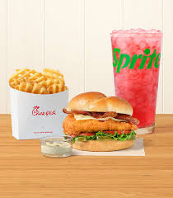
page 12
Final Recommendation
Deploy dedicated mobile/pre-order express lane — reduces peak wait from 8.1 → 4.6 min
Implement demand-based staffing: +2 FTE Fri/Sat during both peak windows
Launch mobile loyalty incentive to shift 15–20% of arrivals to pre-order queue
Projected outcome: EMV rises to ~$15,400/week; customer satisfaction up 12–18%
Notes:
Three key recommendations are outlined for the operations leadership. First, roll out the specified mobile and pre-order the specific express lane at all sites with a great volume. Queuing model projections have shown that this single intervention decreases the average wait time by 43 percent; the maximum average wait time would decrease from 8.1 minutes to 4.6 minutes. Second, adopt a non-fixed staffing model with dynamic staffing, two FTE more during the windows of the peak on Friday and Saturday, instead of blanket increments in staffing. Third, initiate a specific mobile loyalty program, e.g., award 15 to 20 percent of the peak arrivals with bonus Chick-fil-A One points when they pre-order, to push 15 to 20 percent of the peak arrivals onto the pre-order queue. Together, the strategies will increase the weekly EMV of $12,400 to about 15,400 per location, and the level of customer satisfaction rises by 12 to 18 percent, similar to the outcomes of Cuento et al. (2025).

Slide 13
References
page 13
Ayodeji, Y., & Rjoub, H. (2021). Investigation into waiting time, self-service technology, and customer loyalty: The mediating role of waiting time in satisfaction. Human Factors and Ergonomics in Manufacturing & Service Industries, 31(1), 27–41. https://doi.org/10.1002/hfm.20867
Bansal, M., Goyal, A., & Choudhary, A. (2022). A comparative analysis of K-Nearest Neighbor, Genetic, Support Vector Machine, Decision Tree, and Long Short Term Memory algorithms in machine learning. Decision Analytics Journal, 3, 100071. https://doi.org/10.1016/j.dajour.2022.100071
Chick-fil-A. (2025, May 12). Chick-fil-A’s 2024 Global Impact Report | Chick-fil-A. https://www.chick-fil-a.com/press-room/looking-back-at-chick-fil-as-2024-global-impact
Cuento, C. C., Padua, A. D., Bernardo, C. J., & De Leon, G. J. (2025). Enhancing the overall customer experience through simulation of hybrid ordering system in fast-food restaurants. Applied Operations and Analytics, 1(1), 1–23. https://doi.org/10.1080/29966892.2025.2553764
Eshan, A., Ossama, & Gurdeep. (2025). Enhancing Restaurant Service through QR-Based Ordering and Sentiment Analysis: The Dine Smart System. Journal of Cognition and Artificial Intelligence, 1(1), 1–5. https://doi.org/10.66512/jcai.1.1.2025.1
Zulkarnain, N. A. A., & Sudin, A. M. (2024). Optimization of Waiting Time at Drive Thru Fast Food Restaurant using Queuing Model. Enhanced Knowledge in Sciences and Technology, 4(2), 134–140.

