Slide 1



Summative Assessment: Clinical Judgement Define the Problem Presentation
Presented By :
Veron

Slide 2



Agenda
Problem Identification & Background
Data & Evidence Supporting the Problem
Ethical, Legal & Regulatory Concerns
EBP Question & Proposed Intervention
Implementation & Evaluation Plan
Conclusion & Call to Action
Notes:
This presentation has been divided into six sections. We start by defining the clinical issue of high rates of CAUTIs in our medical-surgical unit and outlining the reasons why the issue needs immediate intervention. Then, we consider qualitative and quantitative data, such as QI reports, patient satisfaction surveys, and benchmarking evidence, which fall within the scope of the problem. Then we consider the ethical, legal, and regulatory issues that can influence the way we should treat this practice change. Based on this, we introduce our formally constructed EBP question and the bundle intervention that we propose, which is driven by nurses. The implementation and evaluation plan provides us with the step-by-step implementation and the success metrics. Our call to action is a strong way to finish, which highlights the importance of all nurses eradicating unnecessary patient harm.

Slide 3


The Local Problem
CAUTI rate is 2.8 per 1,000 catheter days (unit average, last 6 months)
National benchmark target is ≤1.0 per 1,000 catheter days
3 of 5 patients with CAUTIs required extended hospitalization
Staff inconsistently document catheter necessity daily
Notes:
Our medical-surgical unit has been getting the CAUTI rate of 2.8 per 1000 days on the catheter, more than the national average of 1.0 per 1000 days. In the team huddles and chart audit, we found out that three out of five CAUTI patients had extended hospitalization that took 3-5 extra days. There is also inconsistency among nursing staff in recording the need to have the catheter daily, implying the absence of definite clinical reasons as to why the catheters are retained (Gupta et al., 2023). This information indicates that there is a severe safety gap in patients that has to be approached urgently by implementing an evidence-based practice project in a structured way.

Slide 4

Why This Problem Matters
CAUTIs increase patient mortality risk by up to 35% (Wang et al., 2022)
Each CAUTI episode adds approximately $1,000–$4,700 in hospital costs (Wang et al., 2022)
CMS no longer reimburses hospitals for CAUTI-related care (Wang et al., 2022)
Prolonged catheter use reduces patient mobility and quality of life (Wang et al., 2022)
Notes:
CAUTIs are some of the preventable healthcare-associated infections, but they have serious consequences. The studies prove that mortality rates are under a serious threat when bloodstream infections are caused by untreated CAUTIs (Wang et al., 2022). Each episode costs thousands more in terms of money, and since 2008, the Centers for Medicare and Medicaid Services (CMS) has refused to provide reimbursement to hospital-acquired CAUTIs. In addition to expense, patients report pain and stiffness, anxiety, and extended use of urinary catheters. It is moral and a financial priority to solve this issue. The lack of action continues to cause harm that can be prevented and institutional financial liability.

Slide 5

Gaps in Current Management
No standardized daily catheter necessity review process in place
Catheter insertion bundles are available but inconsistently used
Nursing documentation of catheter indication is incomplete in 60% of charts
No formal nurse-driven removal protocol currently exists
Notes:
The case study analysis on 40 patient records indicated that 60% of them did not fully document catheter indication, which is one of the prerequisites of safe catheter management. Although there are catheter insertion bundles at the unit, compliance is uneven, shift to shift, and among nurses. No formal nurse-driven catheter removal protocol exists whereby the nurse has to wait until a physician order comes when it is evident that the clinical need has passed. This knowledge gap in the workflow slows down the prompt elimination and exposes a greater risk of infection. Lack of standardized processes leads to variability in the provision of the care process that compromises patient safety and reduces the ability to maintain quality improvement.

Slide 6

Data Indicating the Problem
6 confirmed CAUTIs reported in the past quarter (Q1 2025)
Average catheter dwell time is 6.2 days vs. recommended ≤4 days
70% of catheters reviewed lacked documented daily reassessment
Patient satisfaction scores related to comfort dropped 12% this year
Notes:
The hard facts recorded in Q1 2025 indicate that there are six confirmed CAUTIs in our unit, which qualifies as the Consciousness of quality, as per the hospital policy. The mean dwelling time of 6.2 days on the catheter is far more than the four days recommended as an evidence-based guideline. A focus chart review revealed that 70 percent of catheterized patients did not receive daily documentation of the continued need for the catheter. Moreover, physical comfort scores with regard to patient satisfaction dropped by 12% than it was last year. These numerical results form an irrefutable basis for a structured evidence-based practice intervention that needs to be identified as an urgent intervention for CAUTI prevention.

Slide 7

Medical-surgical patients with urinary catheters experience infection rates exceeding safe benchmarks
Problem Statement
Lack of standardized daily reassessment and nurse-driven removal protocols drives prolonged catheter use
An evidence-based bundle intervention is needed to reduce CAUTI incidence
Notes:
Catheter-associated urinary tract infection (CAUTI) rates for patients with indwelling urinary catheters in medical-surgical settings often surpass established safety guidelines, and can be attributed to modifiable factors in the care process. A key factor is placing no formal protocol for daily assessment of catheter necessity in place, which leads to prolonged catheter use. For instance, a patient admitted with acute urinary retention may not have their catheter removed for days after they begin passing urine spontaneously because there is no established process or reminder to do so. And until a nurse-driven protocol prompts removal, they wait for an order, which delays the removal and increases risk of infection. Anecdotal evidence shows how change of shift, heavy patient caseloads or responsibility becomes blurred, making catheter removal less likely and contributing to "catheter inertia". Research indicates the longer the catheter is in place, the higher the risk of infection. Adopting an evidence-based catheter care bundle, such as checklists for daily reassessment of necessity; automatic stop orders; aseptic catheter insertion; and allowing nurses to remove catheters according to specific criteria, has significantly decreased CAUTI rates. Facilities implementing such bundles can report significant reductions in infection rates, hospital duration and improved patient outcomes, highlighting the need for catheter control through protocol implementation.

Slide 8

This project uses an Intervention EBP Question format
EBP Question Type — Intervention
A comparison will be made between current practice and bundle implementation
Outcome of interest: reduction in CAUTI rate per 1,000 catheter days
Notes:
Based on the framework of Johns Hopkins EBP Question Development Tool, our team chose an EBP question of intervention type. It is a suitable format by virtue of our having enough baseline data available and clinical savvy to suggest a particular, targeted intervention, instead of a general overview of an unknown field. The current standard of practice on the unit will be compared to our intervention — a nurse-driven CAUTI prevention bundle. The main outcome of interest would be determined as a significant decrease in the CAUTI rate per 1,000 catheter days, which would lead our unit to the national goal of 1.0 or fewer infections per 1,000 catheter days.

Slide 9
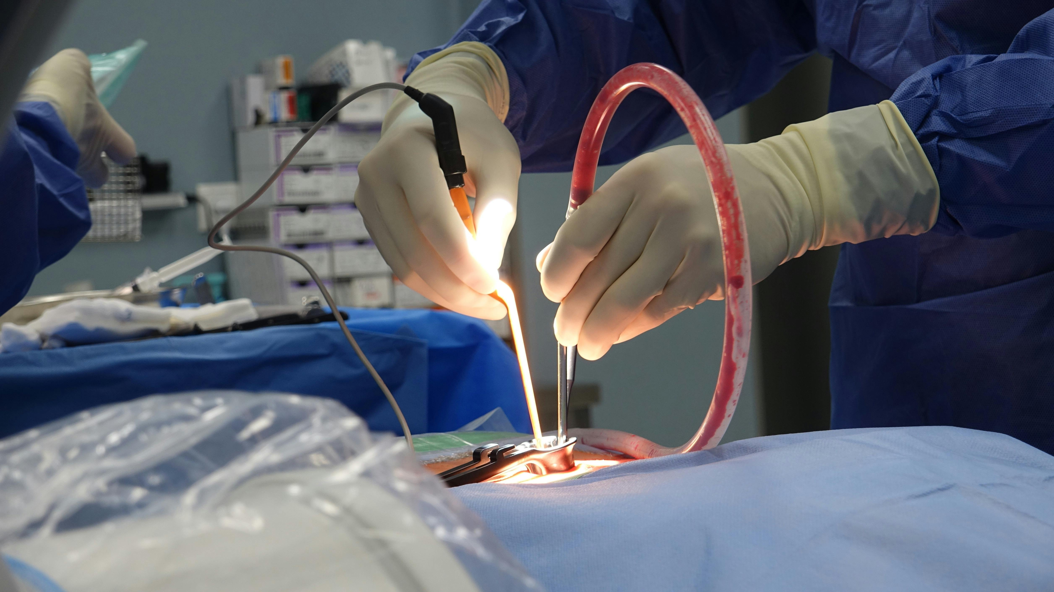
The EBP Question
EBP Question: "According to the evidence, among adult medical-surgical patients with indwelling urinary catheters, what is the impact of a nurse-driven CAUTI prevention bundle as compared to standard care on CAUTI rates per 1,000 catheter days?"
Notes:
Our team created the following EBP question in the Johns Hopkins EBP question template: "In adult nonacute medical-surgical patients with indwelling urinary catheters, how does a nurse-led CAUTI prevention bundle versus standard care affect CAUTI rates per 1,000 catheter days based on evidence? This is a narrow, quantifiable, and practical question. It defines our population unambiguously, the intervention and comparator, and provides a measurable outcome. This framework will be used to direct our literature search process, the appraisal of evidence, and finally, the design and assessment of our practice change initiative.

Slide 10


Outline of the EBP Proposal
Implement a nurse-driven CAUTI prevention bundle on the med-surg unit
Bundle includes: daily necessity review, early removal criteria, and hygiene protocol
Education rollout planned for all med-surg nursing staff over 4 weeks
Outcomes monitored monthly for 6 months post-implementation
Notes:
The suggested intervention is an evidence-based nurse-led CAUTI prevention bundle based on evidence-based guidelines, such as HICPAC (Healthcare Infection Control Practices Advisory Committee) recommendations. The bundle comprises three core procedures: a structured daily catheter need assessment with a standard checklist, nurse-initiated removal criteria that enable nurses to take away catheters when clinical indications cease, and a reinforced routine maintenance protocol. Preimplantation will be conducted with a four-week staff education program. The rate of CAUTI will be measured monthly over six months after implementation to measure the effectiveness and implement refinements. Such a gradual process will guarantee employee preparedness and evidence-based analysis.

Slide 11

Evidence Supporting the Intervention
Nurse-driven removal protocols reduce CAUTI rates by up to 50% (Gesmundo et al., 2022).
Daily reassessment checklists decrease unnecessary catheter days significantly
Bundle compliance above 80% correlates with sustained CAUTI rate reductions (CDC, 2025).
Staff education is a key predictor of bundle adherence and success.
Notes:
Nurse-driven CAUTI prevention bundles are evidence-based. Wang et al. (2022) showed that CAUTI reductions up to 50 percent were achieved through nurse-led removal protocols in medical-surgical units. Single-day reassessment checklists have continually demonstrated a decrease in avoidable catheter days in various hospitals. Research also establishes that bundle compliance rates that are higher than 80% are closely linked to the long-term, lasting reductions in CAUTI (CDC, 2025). More importantly, the aspect of staff education is the strongest predicting factor of bundle adherence. The results confirm that our proposed intervention is evidence-based and viable to be implemented in our unit with adequate preparation.

Slide 12

Ethical Concerns
Patient must consent to catheter placement and removal decisions
Nurses must balance protocol-driven removal with individual patient clinical needs (Kelly et al., 2025)
Vulnerable populations (elderly, cognitively impaired) require additional safeguards
Premature removal must not increase patient risk
Notes:
Acknowledging patient autonomy is fundamental in safe urinary catheter use, and patients should be knowledgeable about their catheter, both when it is inserted and when it is removed if possible. Such explanations should include the reason, risks (discomfort, infection) and alternatives. For example, a surgical admission may initially agree to catheter insertion but later report discomfort or seek removal: including the patient in the reassessment process ensures patient trust and adherence to management decisions. However, nurses need to navigate between protocol-based guidelines for catheter removal and clinical decision-making. For example, though a catheter may be removed on day one post-surgery according to a checklist, a patient with residual urinary retention or unstable vital signs may require longer catheterization; adhering to the protocol here could be dangerous. Elderly patients or those with cognitive deficits need special attention such as including family or surrogates, simple and clear communication, among other precautions. Anecdotally, agitation in such patients may result in catheter removal, with the risk of trauma or infection. Lastly, removal too soon should be avoided to prevent complications such as urinary retention, bladder distention or re-catheterization (which ironically raises the risk for infection). Thus, safe practice follows blending evidence-based guidelines with patient-centred, ethically-driven clinical reasoning.

Slide 13

Legal Concerns
Nurse-driven protocols must fall within state nurse practice act scope of practice
Standing orders for catheter removal require physician authorization and hospital approval
Adverse outcomes from premature removal may lead to disciplinary or legal action
Notes:
Ethical issues should be properly considered prior to the adoption of a nurse-led elimination process. The scope of independent nursing practice is spelled out in each state nurse practice act; in most states, the removal of catheters without a physician directive is within the nursing scope of practice only when there is a properly authorized, standing order that references it . The nurse-driven protocol and standing order should be reviewed by the legal and compliance team of our institution and be approved for implementation afterward. Unfinished catheter records as we have them now (60 percent of our charts) pose enormous personal and operational liability. Catheter removal also presents any threat, out of which events, like urinary retention, must be well recorded and handled as per the protocol to ensure that the patient and the nursing staff are safe.

Slide 14

Regulatory Concerns
The Joint Commission (TJC) requires documented infection prevention programs
CMS Conditions of Participation mandate CAUTI surveillance and reporting
NDNQI benchmarks track CAUTI rates nationally for quality comparison
OSHA standards require proper PPE use during catheter care procedures
Notes:
There are various regulatory frameworks that this EBP project intersects. Accredited hospitals must have an active infection prevention program, and CAUTI rates are one of the indicators that are monitored by the Joint Commission (Ling et al., 2023). CMS Conditions of Participation mandate that healthcare-associated infections, such as CAUTIs, are reported using the CDC National Healthcare Safety Network (NHSN). The rates of our unit are compared to the National Database of Nursing Quality Indicators (NDNQI), and the existing rates can be publicly compared. Personal protective equipment must also be included in our education program since they are regulated under OSHA regulations during catheter care. Institutional accreditation, reimbursement, and public accountability are based on regulatory compliance.

Slide 15
Rationale for Selecting CAUTIs as the Focus
CAUTIs are among the top 5 preventable hospital-acquired infections nationally
Direct patient harm observed by our team during daily clinical practice
Unit data provides a clear, measurable baseline for improvement
Strong evidence base makes this a high-probability-of-success EBP project
Notes:
CAUTI prevention was chosen by our team as it is not only a patient safety issue in the immediate term, but is a high-impact opportunity suitable for measurable change. On-unit nurses were able to directly see patients who were suffering, having a long stay, and were anxious about unnecessary catheter insertion (Kelly et al., 2024). This problem is best suited to an EBP project due to the availability of clear unit-level baseline data, such as documentation compliance rate, dwell times, and infection rate. Also, the wealth of literature that backs up CAUTI prevention bundles run by nurses makes us more confident that the intervention would lead to tangible outcomes. This issue would resonate with our values as nurse leaders: to avoid harm, to impact patient outcomes, and to push quality based on evidence.

Slide 16
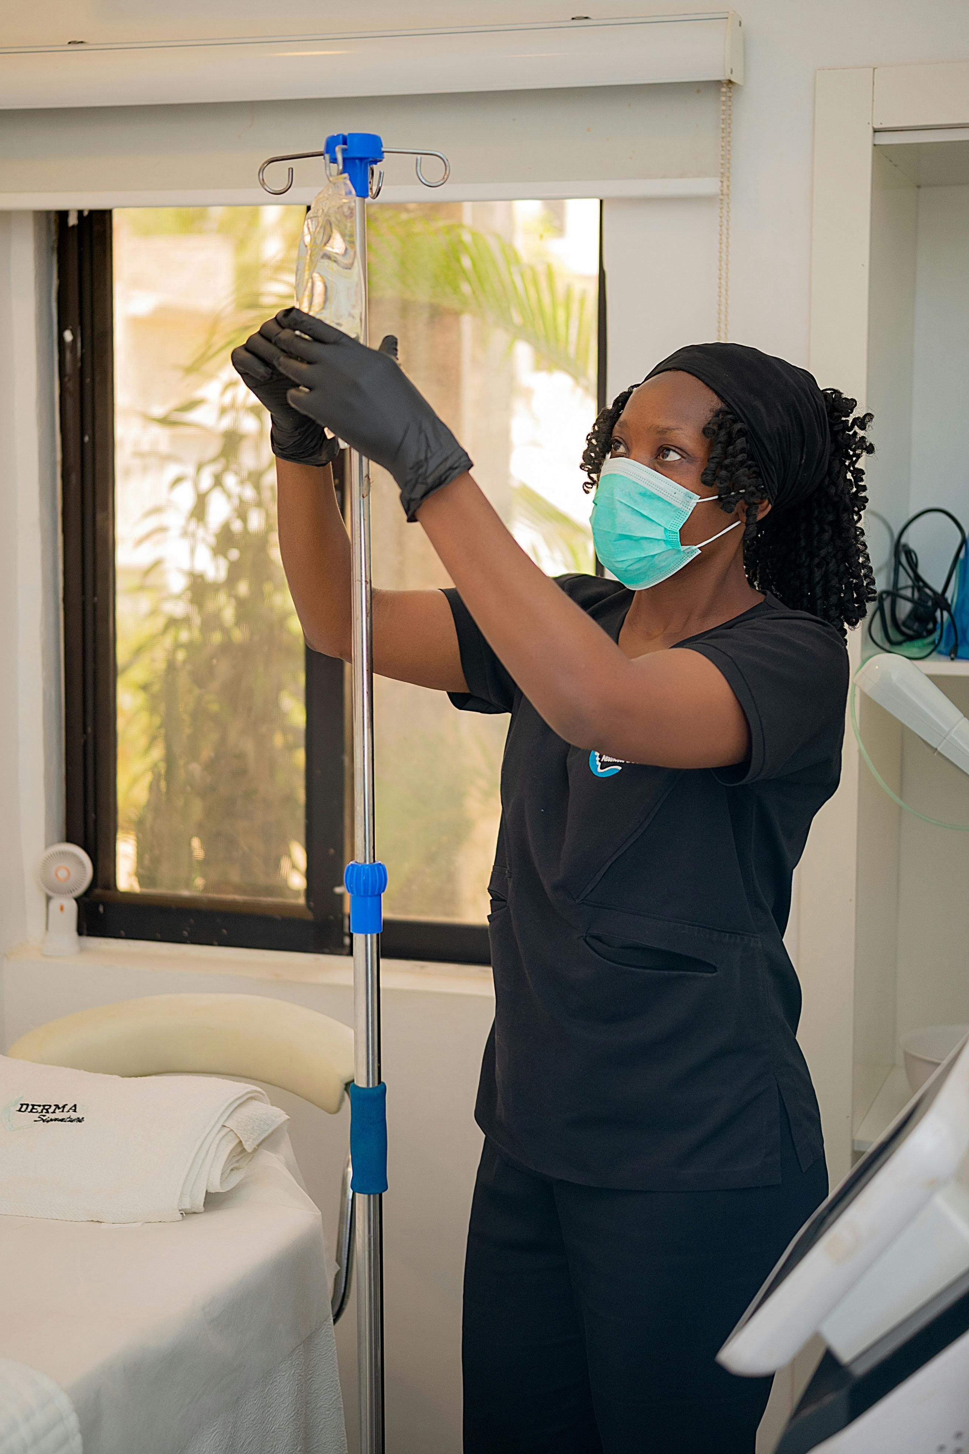
Qualitative Data — Leader and Peer Interviews
Nurse manager reports lack of clear protocol as the top barrier to CAUTI prevention
Staff nurses cite time constraints as a barrier to daily catheter reassessment
Charge nurses note inconsistency in physician responsiveness to removal requests
Peers express willingness to adopt a nurse-driven removal protocol if properly trained
Notes:
Qualitative data was critical and presented interview information among the unit nurse manager, two charge nurses, and five bedside nurses. The nurse manager listed the lack of a standardized protocol as the main structural impact on an individual's steady CAUTI prevention. Bedside nurses reported the high-census shift as a significant issue to daily reassessment achievement based on time pressure. Delay in getting physician orders to remove catheters, even when the clinical need was evidently surpassed, was cited by the charge nurses. In spite of these obstacles, there was high motivation among staff to apply a nurse-based protocol, given sufficient training and administrative backup. This qualitative data will guide us in the design as well as the change management plan of our intervention.

Slide 17

Quantitative Data — QI Reports and Surveys
Facility Quality Improvement Data
Q1 2025 QI report | 6 CAUTIs, costing the unit an estimated $28,200 in non-reimbursed care
Patient satisfaction survey | 68% of catheterized patients reported discomfort as a major concern
Catheter bundle compliance audit | 45% of insertions fully documented
Average catheter dwell time | 6.2 days recorded vs. 4-day evidence-based target
Notes:
The provided quantitative data based on the facility data on the Q1 2025 QI report and a specific patient satisfaction survey is strong evidence in support of the intervention (CDC, 2025). Six CAUTIs resulted in an estimated cost of 28,200, which was not reimbursed by CMS. A survey of patient satisfaction conducted on 25 patients who had just received a catheter insertion showed that 68% of patients who had suffered some catheter-related discomfort during their stay at the hospital listed this as a significant issue, which directly affected the experience scores. A catheter compliance audit obtained a result of 45 percent compliance with the catheter bundles in a satisfaction audit. Along with the 6.2-day average dwell time, these numbers provided a quantitative argument in support of an organized intervention and the sense of urgency that can be expressed in our problem statement.

Slide 18

Benchmarking and Baseline Data
National CAUTI benchmark: ≤1.0 per 1,000 catheter days (NHSN, 2024)
Our unit rate: 2.8 per 1,000 catheter days — 180% above benchmark
Top-performing hospitals with nurse-driven protocols average 0.6 per 1,000 catheter days
Our 6-month post-implementation goal: ≤1.0 per 1,000 catheter days
Notes:
Comparing the CAUTI rate in our unit to the national standards shows that our performance is below the national average. The NHSN 2024 standard of a medical-surgical unit is 1.0 or less CAUTI/ 1000 catheter days. This standard is 180% below our rate of 2.8 in our unit. Analysis of published results of institutions that have adopted nurse-led CAUTI prevention bundles indicates that the best performers have rates as low as 0.6 per 1,000 catheter days. On this basis, our expectation is a 64 percent decrease in CAUTI rate that will bring us to a bottom of 1.0 or less per 1,000 catheter days that will serve as our six-month post-implementation target. It is a clinically meaningful and evidence-based goal that is ambitious.

Slide 19

Gap Between Goals and Current Practice
Hospital goal: zero preventable CAUTIs by end of fiscal year 2025
Current practice does not support goal attainment without structural change
Catheter removal delays and documentation gaps directly undermine the hospital's goal
Without intervention, current trajectory projects 24+ CAUTIs annually on this unit alone
Notes:
The quality objective mentioned by our hospital is equal to zero preventable CAUTIs by the end of fiscal year 2025 - a NHSN-congruent measure that is painted in the annual plan of patient safety (CDC, 2025). The practices that our unit is currently employed in working with do not favor reaching this goal. The lack of a nurse-centered protocol and the timing delays that occur during the removal of catheters are attributed to structural impediments to zero-CAUTI results due to the occasional nature of chronic documentation. Continuing with our Q1 rate projection, we can state that the unit may experience 24 or more CAUTI by the end of the year, as it is projected without the intervention- this is way more than the hospital would allow. In this assessment, it is confirmed that one has to make improvements in a more gradual manner; rather, a formal and evidence-based practice change should be made to fulfill commitments of the institution.

Slide 20

Implementation Plan
Steps to Implement the CAUTI Prevention Bundle
Week 1–2 | Finalize nurse-driven removal protocol and obtain physician/administration approval
Week 3–4 | Deliver mandatory staff education using simulation and return demonstration
Week 5 | Go-live with daily catheter necessity checklist and nurse-driven removal order
Week 6–24 | Monthly CAUTI rate audits with feedback to staff and leadership
Notes:
The implementation plan includes a four-phase six-month implementation plan. In the first two weeks, the EBP team will work on the development of the nurse-led catheter removal protocol alongside the physician champions, and they will gain official consent from the administration and the hospital policy committee. The third and fourth weeks will be devoted to staff training, where simulation scenarios and demonstration of their use through returns are used to guarantee competency. Week 5 will be go-live with the implementation of the daily catheter necessity checklist in the nursing documentation and the nurse-driven removal standing order. Since week six, data audits at the monthly level, consisting of monitoring CAUTI rates, compliance with bundles, and dwell times, will be tracked, and the results will be made transparent to the staff and unit leadership to ensure continued involvement.

Slide 21

Evaluation Plan
Primary outcome: CAUTI rate per 1,000 catheter days monitored monthly
Secondary outcome: catheter dwell time and daily reassessment documentation compliance
Staff survey administered at 3 and 6 months to assess protocol adherence and barriers
Results reviewed by unit council and reported to hospital quality committee quarterly
Notes:
The assessment is incorporated into the project at its inception to promote accountability and allow for corrections to the courses based on data. The primary outcome measure, the CAUTI rate per 1,000 catheter days, will be monthly monitored based on the NHSN data and will be compared to our baseline and the national standard. The secondary outcomes are the mean catheter time and the rate of those patients with a full daily reassessment record. Self-reported protocol adherence, levels of confidence, and ongoing barriers will be assessed in a three and six-month staff survey. All results will be presented at the unit shared governance council and reported formally to the hospital quality and patient safety committee quarterly to make visible the leadership and help it.

Slide 22
Conclusion and Call to Action
Our unit's CAUTI rate of 2.8 per 1,000 catheter days is unacceptable and preventable
Evidence strongly supports nurse-driven bundles as an effective, feasible solution
Ethical, legal, and regulatory frameworks align with and demand this practice change
Every nurse on this unit has the power to prevent patient harm starting today
Notes:
This initiative reflects our effort as a team in ensuring that we can do away with avoidable harm to patients. Our CAUTI rate is almost three times higher than the national average, and the evidence is strong to show that infections could be prevented by up to 50 percent by introducing nurse-led prevention bundles. The moral imperative to safeguard our patients, the legal imperative of protocol-generated care, and the regulatory imperative of TJC and CMS all intersect to render this change of practice not just right, but a mandate. This change is both our responsibility and the clinical authority we, as nursing leaders, have. Each and every daily catheter evaluation done, each and every timely removal activated, each and every bundle action undertaken is directly a patient advocacy and professional excellence act.

Slide 23
References
CDC. (2025, June 27). Clinical Safety: Preventing Catheter-associated Urinary Tract Infections (CAUTIs). Urinary Tract Infection. https://www.cdc.gov/uti/hcp/clinical-safety/index.html
Gupta, P., Thomas, M., Mathews, L., Zacharia, N., Fayiz Ibrahim, A., Garcia, M. L., Simbulan, C., Attia Mohamed, F., & El Hassan, M. (2023). Reducing catheter-associated urinary tract infections in the cardiac intensive care unit with a coordinated strategy and nursing staff empowerment. BMJ Open Quality, 12(2), e002214. https://doi.org/10.1136/bmjoq-2022-002214
Kelly, T., Ai, C., Jung, M., & Yu, K. (2024). Catheter-associated urinary tract infections (CAUTIs) and non-CAUTI hospital-onset urinary tract infections: Relative burden, cost, outcomes and related hospital-onset bacteremia and fungemia infections. Infection Control & Hospital Epidemiology, 45(7), 864–871. https://doi.org/10.1017/ice.2024.26
Ling, M. L., Ching, P., Apisarnthanarak, A., Jaggi, N., Harrington, G., & Fong, S. M. (2023). APSIC guide for prevention of catheter associated urinary tract infections (CAUTIs). Antimicrobial Resistance & Infection Control, 12(1), 52. https://doi.org/10.1186/s13756-023-01254-8
Wang, Y., Gu, Y., & Yu, H. (2022). Correlation between patients’ power distance and their willingness to participate in patients’ safety: A cross-sectional study. Journal of Nursing Management, 30(5), 1345–1354. https://doi.org/10.1111/jonm.13601

